Slide 1

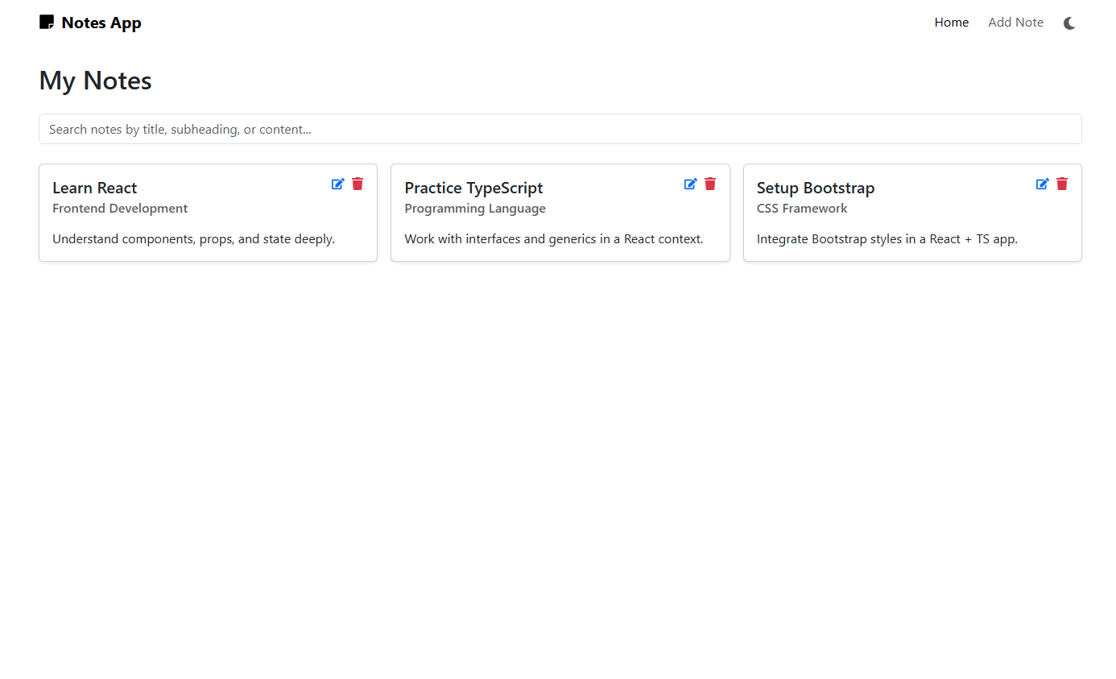
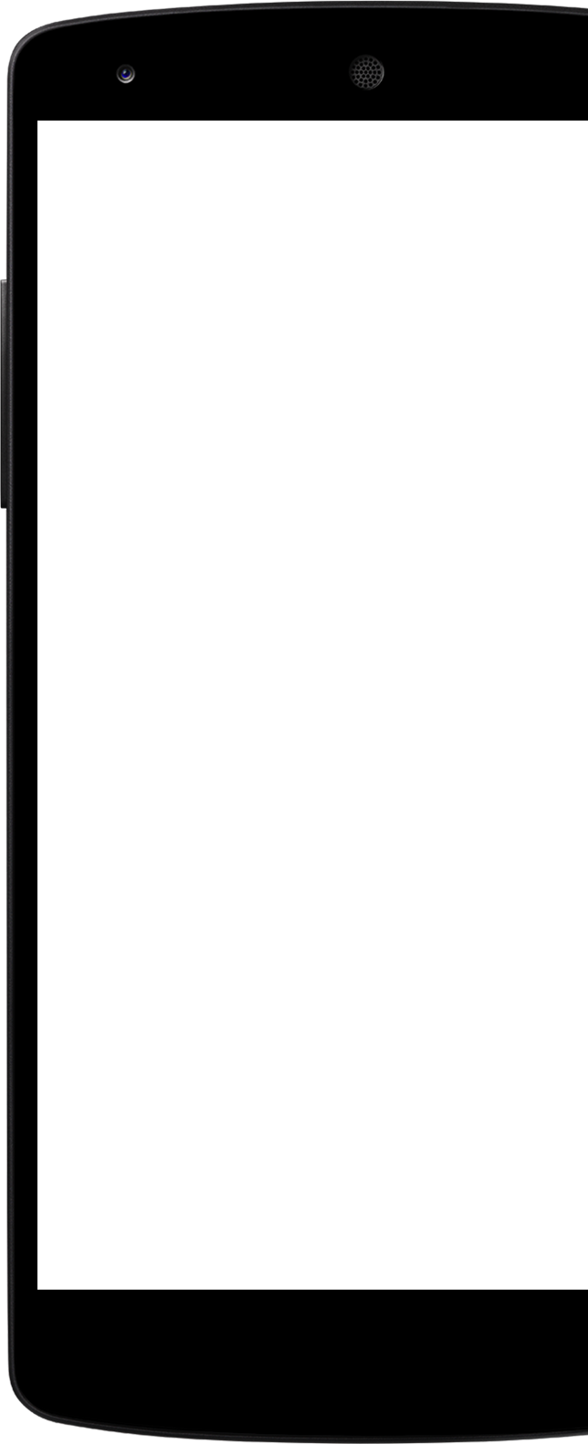
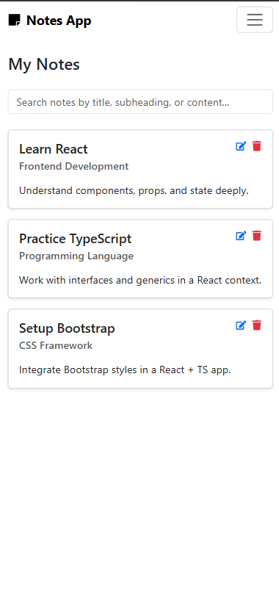

React
Workshop
By TOP ENGINEERS

Slide 2
Prerequisite
Install VS Code | https://code.visualstudio.com/download
Install Git | https://git-scm.com/install
Vercel | https://vercel.com
Git Hub | https://github.com
Install Node | https://nodejs.org/en/download

Slide 3
Why Frontend Development? And Where it stands:
Frontend is what users directly interact with
It focuses on user experience, usability, and design
Connects visual interface to backend systems
Defines how users perceive and navigate digital products
Sits between UI design and backend logic.
Acts as a bridge converting business logic into user actions

Slide 4
React, Angular, and Vue
Each solves frontend challenges differently
Angular and Vue are frameworks: full ecosystem for routing, state, forms, etc
React is a library: focused only on UI, gives freedom to pick other tools
Angular = opinionated and structured
React = flexible and modular
Vue = balanced between simplicity and structure

Slide 5
JSX and How React Handles It
JSX = JavaScript XML: allows writing HTML in JavaScript
Transpiled by Babel into React.createElement() calls
Enables declarative UI building
Example:
const element = <h1>Hello, world!</h1>
React converts this into efficient virtual DOM elements

Slide 6
State
Props
Managed within the component
Similar to local variables
Mutable - changes trigger re-render
Used to track dynamic data or UI updates
Passed from parent to child components
Simiilar to Function Args
Immutable - Read-only
Used for component configuration

Slide 7
React Hooks
Introduced in React 16.8 to use state and lifecycle features in functional components
useState: Manage local state
useEffect: Handle side effects (like fetching data)
useContext: Access global context
useRef: Reference DOM elements
useMemo & useCallback: Optimize performance
Custom Hooks: Created by combining existing hooks for reusable logic

Slide 8
Bootstrap
CSS framework for responsive design
Uses grid system (rows, columns)
Predefined utility classes for margin, padding, typography
Makes UI development faster and consistent
Example classes
.container, .row, .col
.btn, .btn-primary
.text-center, .mt-3

Slide 9
React Context and Providers
Context helps pass data across components without prop drilling
Provider makes data available to its descendants
Consumer (or useContext) reads the data
Example
const MyContext = React.createContext();
<MyContext.Provider value={data}>...</MyContext.Provider>

Slide 10
Web Communication & REST APIs
Frontend communicates with backend via APIs
REST = Representational State Transfer
Stateless communication using HTTP methods
Frontend sends requests; backend responds with JSON/XML
Enables data fetching, posting, updating, and deletion

Slide 11
HTTP Methods (REST API)
GET → Retrieve data
POST → Create new resource
PUT → Update existing resource
PATCH → Partially update resource
DELETE → Remove resource

Slide 12

Questions?

Slide 13
Thank You

